Slide 1
Data Science Capstone Project Report
Predicting SpaceX Falcon 9 First-Stage Landing Success
Luqman Syahrulnizam · 10 November 2026
GitHub: https://github.com/Downey112/ibm-ds-capstone-spacex
Notes:
Good day. This is my IBM Applied Data Science Capstone. I predict whether a Falcon 9 first stage will land successfully, because that drives the cost of a launch.

Slide 2
Outline
• Executive Summary
• Introduction
• Methodology
• Results
– Exploratory data analysis (visualisation and SQL)
– Interactive analytics (Folium map, Plotly Dash)
– Predictive analysis (classification)
• Conclusion
• Appendix
IBM Applied Data Science Capstone · SpaceX Falcon 9
Notes:
I will go from the problem, through how I collected and prepared the data, to what the analysis and models found.

Slide 3
Executive Summary
• Methods: SpaceX REST API + Wikipedia web scraping → data wrangling → EDA with charts and SQL → Folium map + Plotly Dash → 4 classifiers tuned with GridSearchCV
• Data: 90 Falcon 9 launches (Falcon 1 removed); overall landing success 66.7% (60/90)
• Trend: landing success rose from 0% (2010–2013) to 90% (2019) and 84% (2020)
• Drivers: flight experience, orbit type, launch site and booster version
• Models: Logistic Regression, SVM, Decision Tree and KNN all reach 83.3% test accuracy (15/18); Decision Tree has the best cross-validation score (86.3%)
• Main error type: false positives (predicting a landing that failed)
IBM Applied Data Science Capstone · SpaceX Falcon 9
Notes:
I combined API and scraped data on 90 Falcon 9 launches. Landing success improved sharply over time. All four tuned models predict the outcome with 83% accuracy on held-out data; their main weakness is being too optimistic about failed landings.

Slide 4
Introduction
• Background: SpaceX advertises Falcon 9 launches at ~$62 million; other providers charge upward of $165 million. Much of the saving comes from reusing the first stage.
• Why it matters: if we can predict whether the first stage will land, we can estimate the cost of a launch. That helps a competitor bidding against SpaceX.
• Problem: can mission features (payload mass, orbit, launch site, flight number, booster details) predict a successful first-stage landing?
• Questions:
– Which factors drive landing success?
– Which sites and orbits have the best record?
– Which classification model predicts best?
IBM Applied Data Science Capstone · SpaceX Falcon 9
Notes:
Reusing the first stage is SpaceX's cost advantage. Predicting the landing therefore tells us the likely launch price, which is what an alternative launch company bidding against SpaceX would want to know.

Slide 5
Methodology
Data collection · wrangling · EDA · interactive analytics · predictive analysis

Slide 6
Methodology Overview
Methodology
Data collection
SpaceX API + web scraping
Data wrangling
clean, label, encode
EDA
visualisation + SQL
Interactive analytics
Folium + Plotly Dash
Predictive analysis
4 tuned classifiers
• Data collection: SpaceX REST API v4 and BeautifulSoup scraping of Wikipedia
• Data wrangling: filtering, missing values, binary Class label, one-hot encoding
• EDA: Matplotlib/Seaborn charts and SQL queries in SQLite
• Interactive visual analytics: Folium map and Plotly Dash dashboard
• Predictive analysis: StandardScaler → train/test split → GridSearchCV (LR, SVM, Decision Tree, KNN) → evaluate
IBM Applied Data Science Capstone · SpaceX Falcon 9
Notes:
The project follows the standard data science pipeline, from collection through to modelling.

Slide 7
Data Collection – SpaceX API
Methodology
GET /v4/launches/past
json_normalize → DataFrame
ID lookups: rockets, launchpads, payloads, cores
Filter: 1 core, 1 payload, date ≤ 2020-11-13
Remove Falcon 1 → 90 launches
Impute PayloadMass (mean) → CSV
• Request: requests.get("https://api.spacexdata.com/v4/launches/past") → response.json()
• Helper functions turn IDs into BoosterVersion, LaunchSite + coordinates, PayloadMass + Orbit, and core details (Outcome, Flights, GridFins, Reused, Legs, LandingPad, Block, Serial)
• Missing PayloadMass replaced with the mean; LandingPad keeps None (26 rows) to mean "no landing pad used"
IBM Applied Data Science Capstone · SpaceX Falcon 9
Notes:
The API gives IDs rather than names, so I made extra calls to get booster, site, payload and landing details. After filtering out Falcon 1, 90 Falcon 9 launches remained.

Slide 8
Data Collection – Web Scraping
Methodology
requests.get(URL)
oldid=1027686922
BeautifulSoup
(html)
soup.find_all
("table")
Column names from <th>
Parse each row → dict
pd.DataFrame → CSV
• Page: "List of Falcon 9 and Falcon Heavy launches"; soup.title = List of Falcon 9 and Falcon Heavy launches - Wikipedia
• Third table = launch records; header cells cleaned with extract_column_from_header()
• Columns: Flight No., Date, Time, Version Booster, Launch site, Payload, Payload mass, Orbit, Customer, Launch outcome, Booster landing
IBM Applied Data Science Capstone · SpaceX Falcon 9
Notes:
I scraped a fixed revision of the Wikipedia page so the results are reproducible. The launch tables were parsed into a DataFrame as a second data source.

Slide 9
Data Wrangling
Methodology
• Launches per site: CCAFS SLC 40 = 55 · KSC LC 39A = 22 · VAFB SLC 4E = 13
• Orbits: GTO 27 · ISS 21 · VLEO 14 · PO 9 · LEO 7 · SSO 5 · MEO 3 · ES-L1, HEO, SO, GEO 1 each
• Class label: 1 = landed (True ASDS / True RTLS / True Ocean), 0 = otherwise → 60 vs 30 → 66.7% success
• One-hot encoding of Orbit, LaunchSite, LandingPad, Serial → 83 features, cast to float64
Outcome | Count | Class
True ASDS | 41 | 1
None None | 19 | 0
True RTLS | 14 | 1
False ASDS | 6 | 0
True Ocean | 5 | 1
False Ocean | 2 | 0
None ASDS | 2 | 0
False RTLS | 1 | 0
IBM Applied Data Science Capstone · SpaceX Falcon 9
Notes:
The raw outcome mixes landing type with success or failure. I turned it into one binary label, then one-hot encoded the categorical columns for the models.

Slide 10
EDA with Data Visualization
Methodology
• Scatter plots, coloured by landing outcome (Class), to see how two variables together relate to success:
– Flight Number vs Launch Site · Payload Mass vs Launch Site
– Flight Number vs Orbit · Payload Mass vs Orbit · Flight Number vs Payload
• Bar chart: success rate by orbit, to compare categories
• Line chart: yearly success rate, to show the trend over time
• Outcome: these patterns informed which features to keep for modelling
IBM Applied Data Science Capstone · SpaceX Falcon 9
Notes:
Scatter plots show how two features together relate to the outcome. The bar chart compares orbits, and the line chart shows the improvement over time.

Slide 11
EDA with SQL
Methodology
• Loaded Spacex.csv into SQLite (table SPACEXTBL, 101 rows) and queried with %sql
• Unique launch site names · 5 records where the site begins with "CCA"
• Total payload for NASA (CRS) · Average payload for booster F9 v1.1
• Date of the first successful ground-pad landing
• Boosters with a drone-ship success and payload 4,000–6,000 kg
• Count of successful vs failed mission outcomes
• Boosters that carried the maximum payload (subquery)
• 2015 drone-ship landing failures (month, booster, site)
• Ranking of landing outcomes between 2010-06-04 and 2017-03-20
IBM Applied Data Science Capstone · SpaceX Falcon 9
Notes:
SQL was used for exact counts, totals and rankings. The SQL table has 101 rows and slightly different site names from the 90-row modelling dataset.

Slide 12
Interactive Map with Folium
Methodology
• folium.Circle + label marker for each of the 4 launch sites (coordinates from the dataset)
• MarkerCluster of every launch: green = landed (Class 1), red = failed (Class 0)
• MousePosition to read coordinates of nearby features
• Haversine distance + PolyLine from a launch site to the nearest coastline, railway, highway and city
• Purpose: are sites near the equator and the coast? Are they close to transport links but far from cities?
IBM Applied Data Science Capstone · SpaceX Falcon 9
Notes:
The map adds geography: where the sites are, how each site performed, and what infrastructure is nearby.

Slide 13
Dashboard with Plotly Dash
Methodology
• Dropdown: All Sites or a single launch site
• Pie chart: share of successes by site (All Sites), or success vs failure for the selected site
• RangeSlider: payload mass 0–10,000 kg
• Scatter plot: payload vs outcome, coloured by booster version category
• Two callbacks link the inputs to the charts
• Purpose: explore how site, payload and booster version affect success interactively
IBM Applied Data Science Capstone · SpaceX Falcon 9
Notes:
The dashboard lets anyone filter by site and payload, and the charts update instantly through callbacks.

Slide 14
Predictive Analysis (Classification)
Methodology
X = 83 features
Y = Class
StandardScaler
train_test_split
80/20, random_state=2
GridSearchCV cv=10
LR · SVM · Tree · KNN
Test accuracy +
confusion matrix
Pick best model
• 72 training and 18 test launches
• Logistic Regression: C, penalty, solver · SVM: kernel, C, gamma
• Decision Tree: criterion, splitter, max_depth, max_features, min_samples_leaf/split · KNN: n_neighbors, algorithm, p
• Compare best CV score, test accuracy and confusion matrix
IBM Applied Data Science Capstone · SpaceX Falcon 9
Notes:
Each model was tuned with 10-fold cross-validation on the training data, then scored on the same 18-launch test set.

Slide 15
Results
Exploratory data analysis · SQL · interactive analytics · predictive analysis

Slide 16
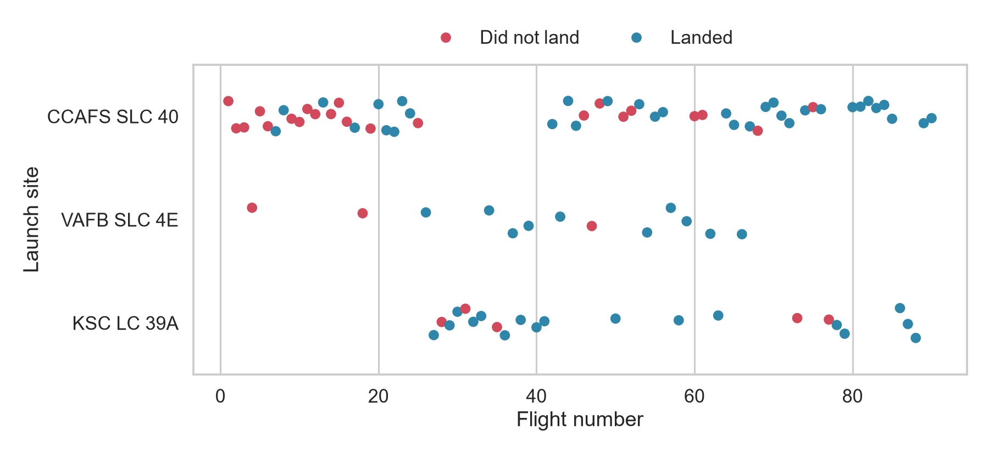
Flight Number vs Launch Site
EDA results
• Most early flights launched from CCAFS SLC 40, which also has the most failures
• VAFB SLC 4E was used from flight 4 to 66; KSC LC 39A from flight 27
• Success rises with flight number at every site
• Experience is a strong predictor
IBM Applied Data Science Capstone · SpaceX Falcon 9
Notes:
Most early launches, and most failures, came from CCAFS SLC 40. As the flight count grows, landings become far more reliable everywhere.

Slide 17
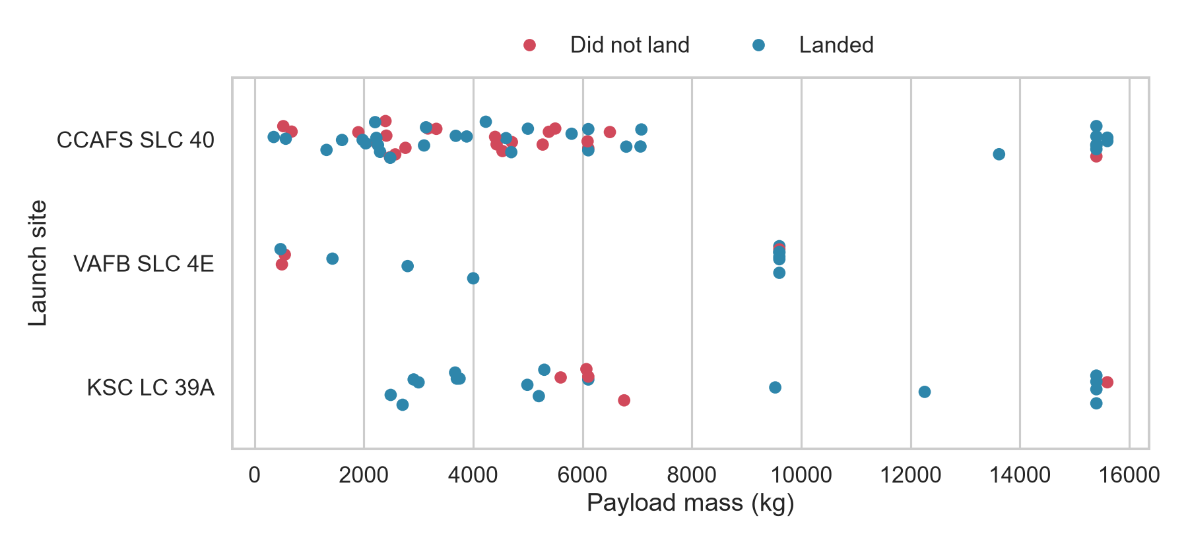
Payload vs Launch Site
EDA results
• CCAFS SLC 40: 350–15,600 kg
• KSC LC 39A: 2,490–15,600 kg
• VAFB SLC 4E: no launches above 10,000 kg (max 9,600 kg)
• Heavy payloads (>10,000 kg) mostly landed
IBM Applied Data Science Capstone · SpaceX Falcon 9
Notes:
VAFB handles only lighter payloads, while the Florida sites take the heaviest missions, which mostly landed.

Slide 18
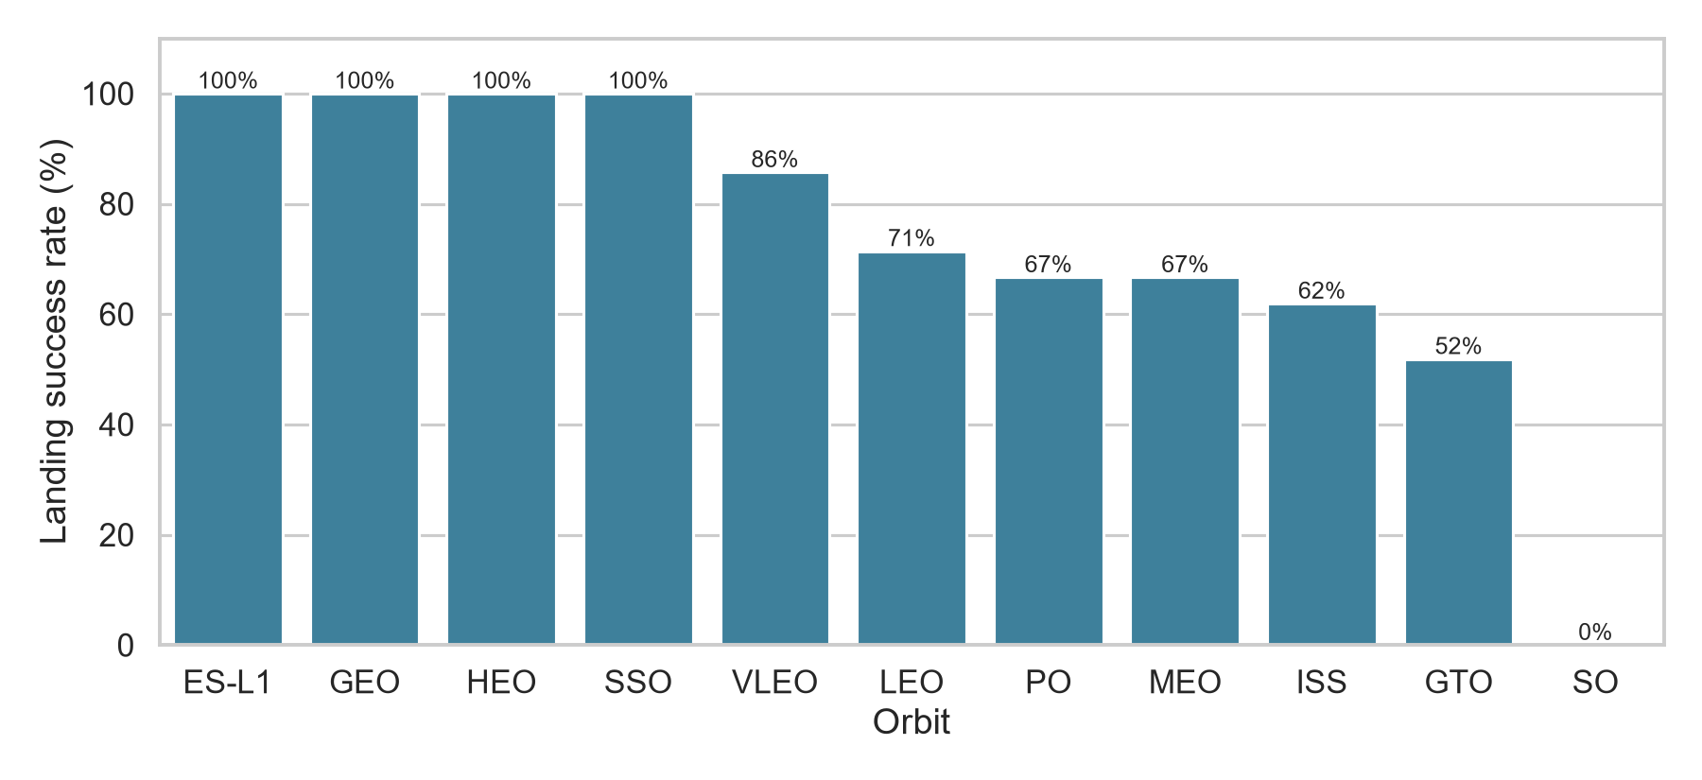
Success Rate by Orbit Type
EDA results
• 100%: ES-L1, GEO, HEO (1 launch each), SSO (5/5)
• VLEO 85.7% · LEO 71.4% · PO 66.7% · MEO 66.7% · ISS 61.9%
• GTO lowest of the common orbits: 51.9% of 27
• SO 0% (1 launch)
• Orbits with 1 launch say little
IBM Applied Data Science Capstone · SpaceX Falcon 9
Notes:
SSO and VLEO are reliable with a meaningful number of launches. GTO, the most common orbit, is close to a coin flip. The 100% orbits with one launch tell us little.

Slide 19
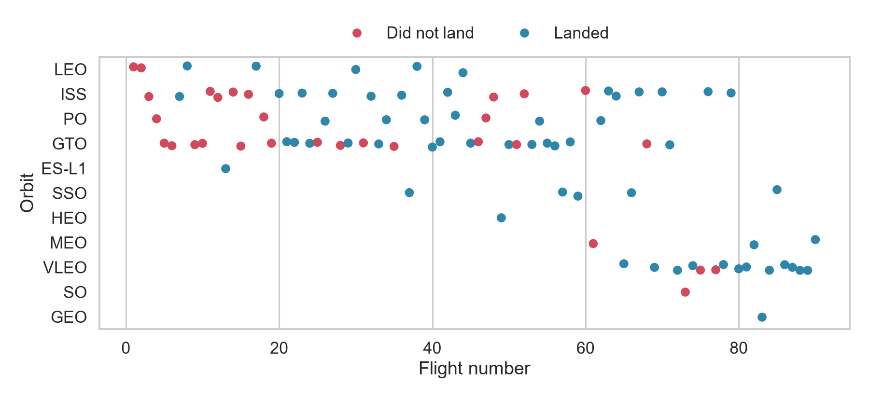
Flight Number vs Orbit Type
EDA results
• Early flights: LEO, ISS and GTO
• VLEO (Starlink) appears from flight 65 and mostly lands
• LEO: success appears related to flight number
• GTO: no clear relationship with flight number
IBM Applied Data Science Capstone · SpaceX Falcon 9
Notes:
The mission mix shifted toward VLEO, which lands reliably, so part of the later success comes from what was being launched.

Slide 20
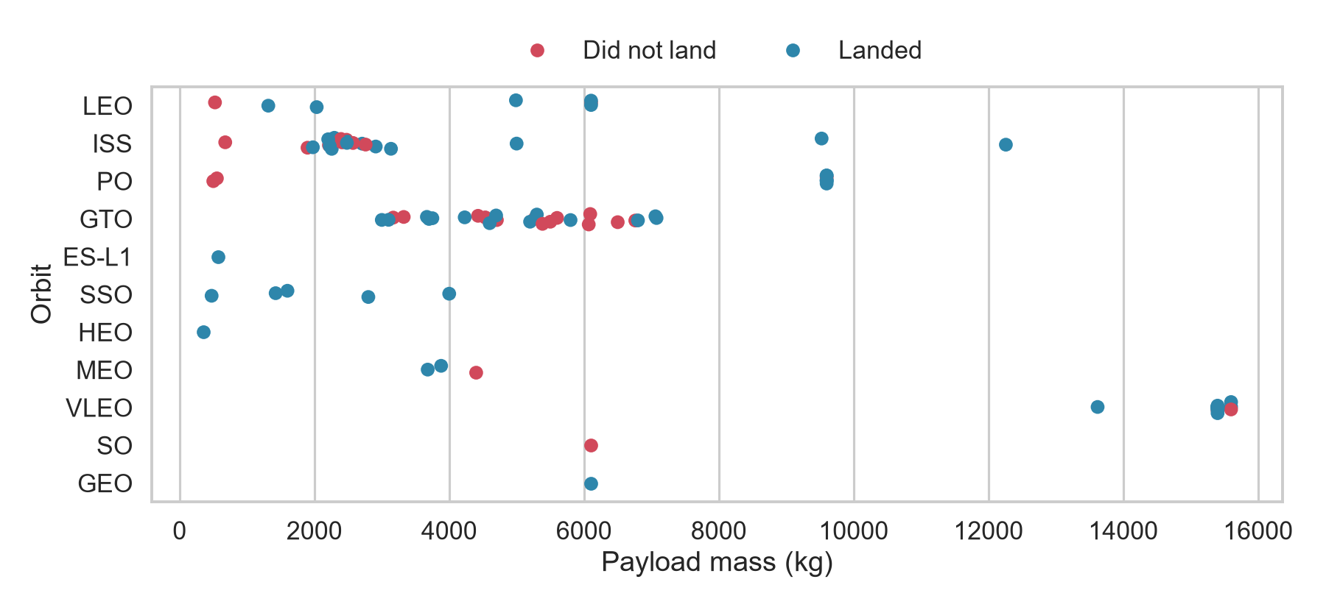
Payload vs Orbit Type
EDA results
• Payloads above 10,000 kg: almost all VLEO (plus one ISS at 12,259 kg)
• Heavy payloads land more often for PO, LEO and ISS
• GTO (3,000–7,076 kg): mixed, no clear pattern
• SSO ≤ 4,000 kg, all landed
IBM Applied Data Science Capstone · SpaceX Falcon 9
Notes:
Heavy payload alone does not mean failure. For GTO, payload mass does not separate successes from failures.

Slide 21
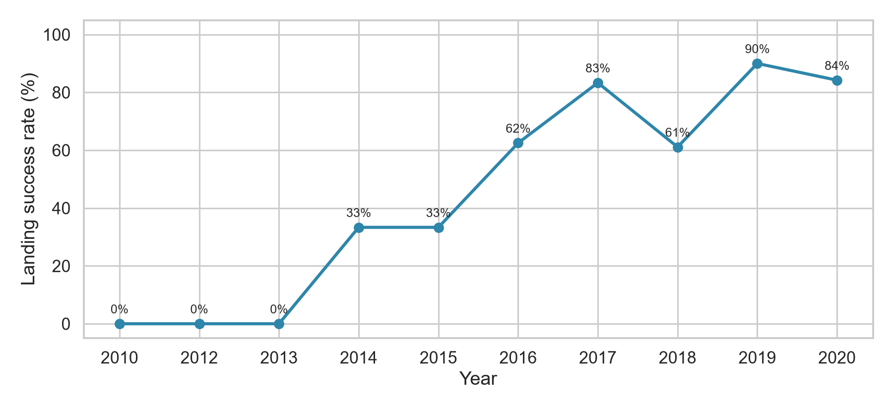
Launch Success Yearly Trend
EDA results
• 2010–2013: 0%
• 2014–2015: 33%
• 2016: 62% · 2017: 83%
• 2018: 61% (a dip)
• 2019: 90% · 2020: 84%
• Clear upward trend since 2013
IBM Applied Data Science Capstone · SpaceX Falcon 9
Notes:
Success rose steadily from 2013, with one dip in 2018, and reached 84 to 90 percent in 2019 and 2020.

Slide 22
All Launch Site Names
SQL results
SELECT DISTINCT Launch_Site FROM SPACEXTBL;
Launch_Site | Launches in table
CCAFS LC-40 | 26
CCAFS SLC-40 | 34
KSC LC-39A | 25
VAFB SLC-4E | 16
IBM Applied Data Science Capstone · SpaceX Falcon 9
Notes:
There are four distinct site names. Cape Canaveral appears under two names.

Slide 23
Launch Sites Beginning with 'CCA'
SQL results
SELECT * FROM SPACEXTBL WHERE Launch_Site LIKE 'CCA%' LIMIT 5;
Date | Booster | Site | Payload | kg | Orbit | Customer | Landing
2010-06-04 | F9 v1.0 B0003 | CCAFS LC-40 | Dragon Spacecraft Qualification Un | 0 | LEO | SpaceX | Failure (parachute)
2010-12-08 | F9 v1.0 B0004 | CCAFS LC-40 | Dragon demo flight C1, two CubeSat | 0 | LEO (ISS) | NASA (COTS) NRO | Failure (parachute)
2012-05-22 | F9 v1.0 B0005 | CCAFS LC-40 | Dragon demo flight C2 | 525 | LEO (ISS) | NASA (COTS) | No attempt
2012-10-08 | F9 v1.0 B0006 | CCAFS LC-40 | SpaceX CRS-1 | 500 | LEO (ISS) | NASA (CRS) | No attempt
2013-03-01 | F9 v1.0 B0007 | CCAFS LC-40 | SpaceX CRS-2 | 677 | LEO (ISS) | NASA (CRS) | No attempt
IBM Applied Data Science Capstone · SpaceX Falcon 9
Notes:
LIKE 'CCA%' filters all Cape Canaveral records. The first five are the earliest Falcon 9 flights.

Slide 24
Total Payload Mass – NASA (CRS)
SQL results
SELECT SUM(PAYLOAD_MASS__KG_) AS total_payload
FROM SPACEXTBL WHERE Customer = 'NASA (CRS)';
• Result: 45,596 kg
• Total payload carried for NASA's Commercial Resupply Services missions
IBM Applied Data Science Capstone · SpaceX Falcon 9
Notes:
NASA resupply missions carried 45,596 kg in total.

Slide 25
Average Payload Mass – F9 v1.1
SQL results
SELECT AVG(PAYLOAD_MASS__KG_) AS avg_payload
FROM SPACEXTBL WHERE Booster_Version = 'F9 v1.1';
• Result: 2,928.4 kg
• Average payload for the F9 v1.1 booster version
IBM Applied Data Science Capstone · SpaceX Falcon 9
Notes:
The F9 v1.1 booster carried 2,928.4 kg on average.

Slide 26
First Successful Ground-Pad Landing
SQL results
SELECT MIN(Date) AS first_success
FROM SPACEXTBL WHERE Landing_Outcome = 'Success (ground pad)';
• Result: 2015-12-22
• Orbcomm OG2 mission from CCAFS LC-40
IBM Applied Data Science Capstone · SpaceX Falcon 9
Notes:
The first successful ground-pad landing was on 22 December 2015.

Slide 27
Drone-Ship Success with Payload 4,000–6,000 kg
SQL results
SELECT Booster_Version FROM SPACEXTBL
WHERE Landing_Outcome = 'Success (drone ship)'
AND PAYLOAD_MASS__KG_ > 4000 AND PAYLOAD_MASS__KG_ < 6000;
• F9 FT B1022 · F9 FT B1026 · F9 FT B1021.2 · F9 FT B1031.2
• All four are Full Thrust boosters; two are re-flown cores (.2)
IBM Applied Data Science Capstone · SpaceX Falcon 9
Notes:
All four boosters are Full Thrust versions, two of them re-flown cores.

Slide 28
Total Successful and Failed Mission Outcomes
SQL results
SELECT Mission_Outcome, COUNT(*) AS total
FROM SPACEXTBL GROUP BY Mission_Outcome;
• Success: 98 · "Success " (trailing space in source): 1 · Success (payload status unclear): 1 · Failure (in flight): 1
• → 100 successful missions, 1 failure
• Mission success is near-perfect; landing the booster is the harder problem
IBM Applied Data Science Capstone · SpaceX Falcon 9
Notes:
Mission success, meaning the payload reached orbit, is nearly perfect. Landing the booster is the harder problem.

Slide 29
Boosters Carrying the Maximum Payload
SQL results
SELECT Booster_Version FROM SPACEXTBL WHERE PAYLOAD_MASS__KG_ =
(SELECT MAX(PAYLOAD_MASS__KG_) FROM SPACEXTBL);
• Maximum payload: 15,600 kg
• F9 B5 B1048.4 · B1049.4 · B1051.3 · B1056.4 · B1048.5 · B1051.4
• F9 B5 B1049.5 · B1060.2 · B1058.3 · B1051.6 · B1060.3 · B1049.7
• Only Block 5 boosters, mostly re-flown, carried the maximum payload
IBM Applied Data Science Capstone · SpaceX Falcon 9
Notes:
Only Block 5 boosters, many of them re-flown, carried the maximum payload.

Slide 30
2015 Drone-Ship Landing Failures
SQL results
SELECT substr(Date,6,2) AS month, Landing_Outcome, Booster_Version, Launch_Site
FROM SPACEXTBL WHERE Landing_Outcome = 'Failure (drone ship)'
AND substr(Date,1,4) = '2015';
Month | Landing outcome | Booster | Launch site
01 (January) | Failure (drone ship) | F9 v1.1 B1012 | CCAFS LC-40
04 (April) | Failure (drone ship) | F9 v1.1 B1015 | CCAFS LC-40
IBM Applied Data Science Capstone · SpaceX Falcon 9
Notes:
Both 2015 drone-ship failures were v1.1 boosters launched from CCAFS LC-40.

Slide 31
Landing Outcomes Ranked (2010-06-04 to 2017-03-20)
SQL results
SELECT Landing_Outcome, COUNT(*) AS n FROM SPACEXTBL
WHERE Date BETWEEN '2010-06-04' AND '2017-03-20'
GROUP BY Landing_Outcome ORDER BY n DESC;
Rank | Landing outcome | Count
1 | No attempt | 10
2 | Success (drone ship) | 5
3 | Failure (drone ship) | 5
4 | Success (ground pad) | 3
5 | Controlled (ocean) | 3
6 | Uncontrolled (ocean) | 2
7 | Failure (parachute) | 2
8 | Precluded (drone ship) | 1
IBM Applied Data Science Capstone · SpaceX Falcon 9
Notes:
In the early years, no attempt was the most common outcome. Drone-ship successes and failures were level at 5 each.

Slide 32
Launch Site Proximity Analysis
Folium interactive map

Slide 33
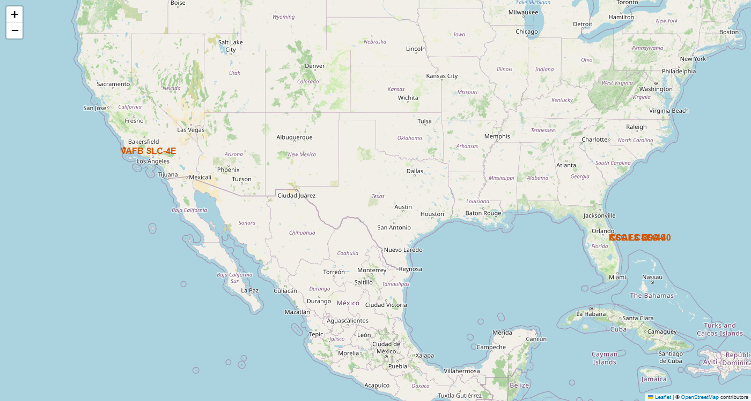
All Launch Sites on a Map
Folium results
• 3 sites in Florida (CCAFS LC-40, CCAFS SLC-40, KSC LC-39A), 1 in California (VAFB SLC-4E)
• All sites are on the coast, so rockets fly over the ocean
• All are in the far south of the US (Florida ≈ 28.5° N), as close to the equator as the mainland allows
IBM Applied Data Science Capstone · SpaceX Falcon 9
Notes:
Sites sit by the coast so rockets fly over water. They are in the south because launching closer to the equator gives extra speed from Earth's rotation.

Slide 34
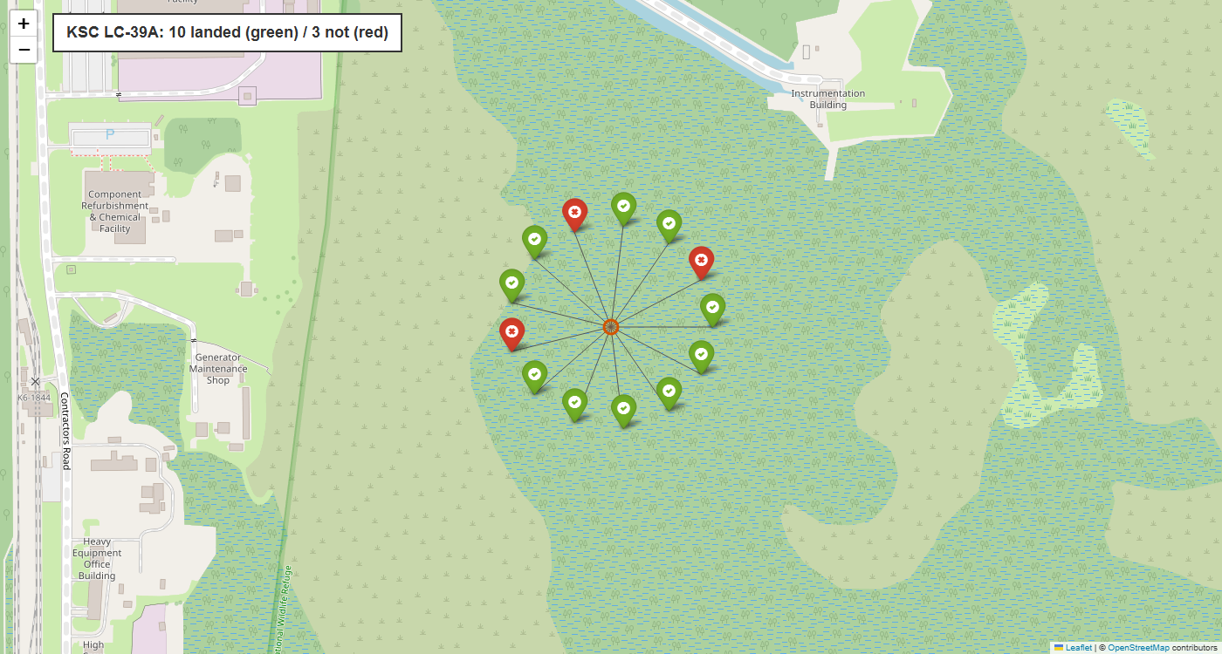
Colour-Labelled Launch Outcomes
Folium results
• Each launch is a marker: green = landed, red = failed
• KSC LC-39A (shown): 10 of 13 landed, the best record of any site
• CCAFS LC-40: 7 of 26 landed (many early flights)
• VAFB SLC-4E: 4 of 10 · CCAFS SLC-40: 3 of 7
IBM Applied Data Science Capstone · SpaceX Falcon 9
Notes:
The colour markers show at a glance which sites have the best landing record. KSC LC-39A is mostly green.

Slide 35
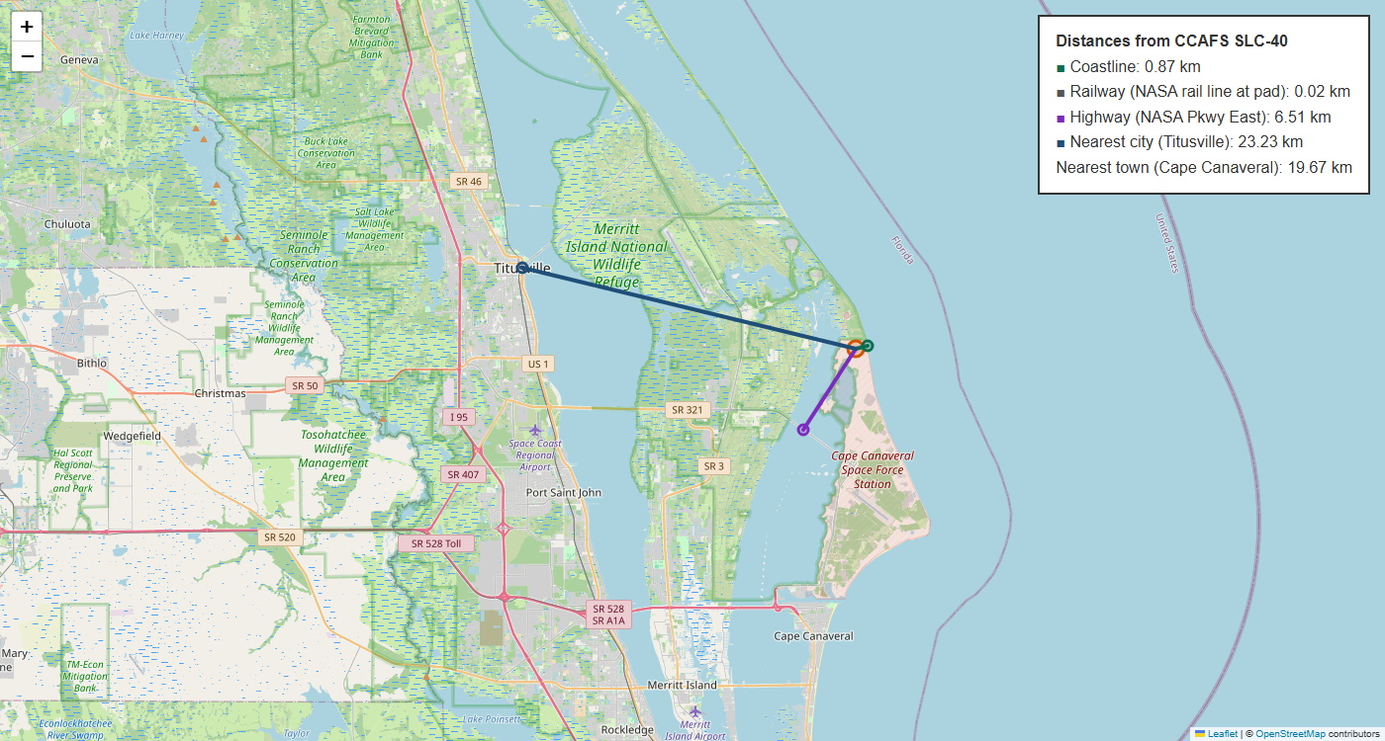
Distances to Coastline, Railway, Highway and City
Folium results
• From CCAFS SLC-40:
– Coastline: 0.87 km
– Railway: 0.02 km (rail line runs to the pad)
– Highway (NASA Pkwy East): 6.51 km
– Nearest city (Titusville): 23.23 km
• Close to coast, rail and road (logistics); far from cities (safety)
IBM Applied Data Science Capstone · SpaceX Falcon 9
Notes:
Sites are close to transport links for moving hardware, but kept away from cities for safety.

Slide 36
Build a Dashboard with Plotly Dash
Interactive dashboard results

Slide 37
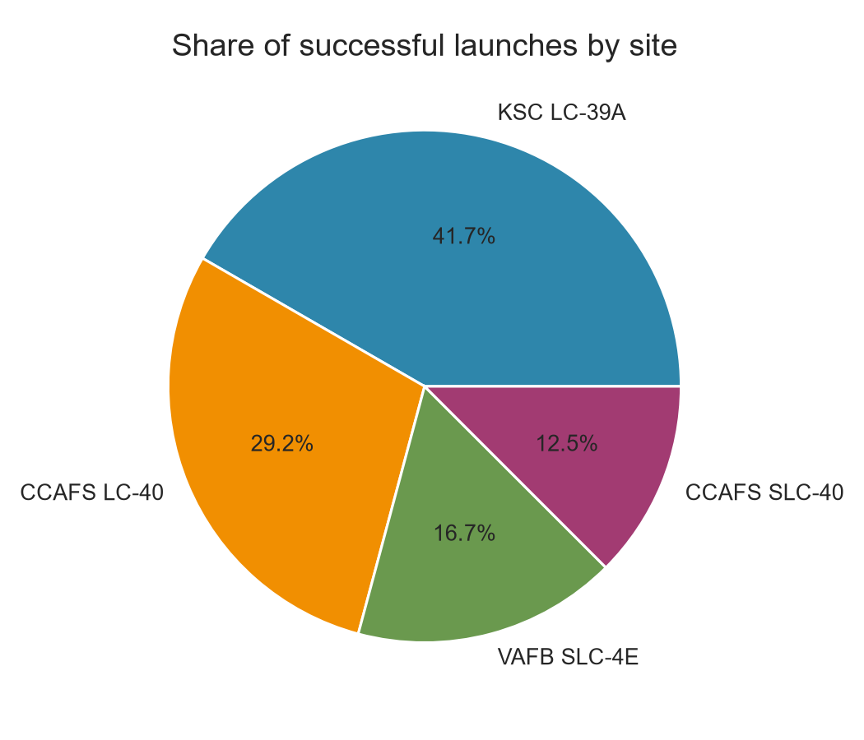
Launch Success Count for All Sites
Dash results
• KSC LC-39A: 41.7% of all successful launches
• CCAFS LC-40: 29.2%
• VAFB SLC-4E: 16.7%
• CCAFS SLC-40: 12.5%
• KSC LC-39A leads the success count
IBM Applied Data Science Capstone · SpaceX Falcon 9
Notes:
KSC LC-39A accounts for the largest share of successful landings.

Slide 38
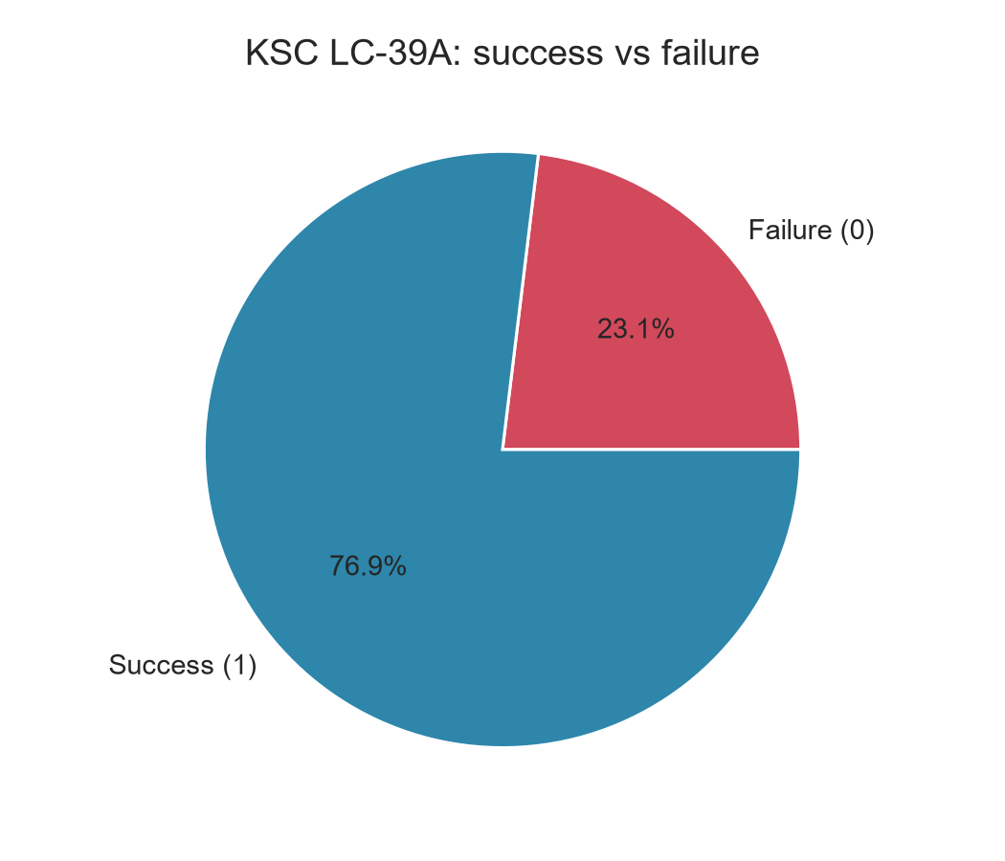
Launch Site with the Highest Success Ratio
Dash results
• KSC LC-39A: 76.9% success (10 of 13)
• 23.1% failure (3 of 13)
• The highest success ratio of any site
IBM Applied Data Science Capstone · SpaceX Falcon 9
Notes:
Selecting KSC LC-39A shows about 77% of its launches landed successfully, the best of all sites.

Slide 39
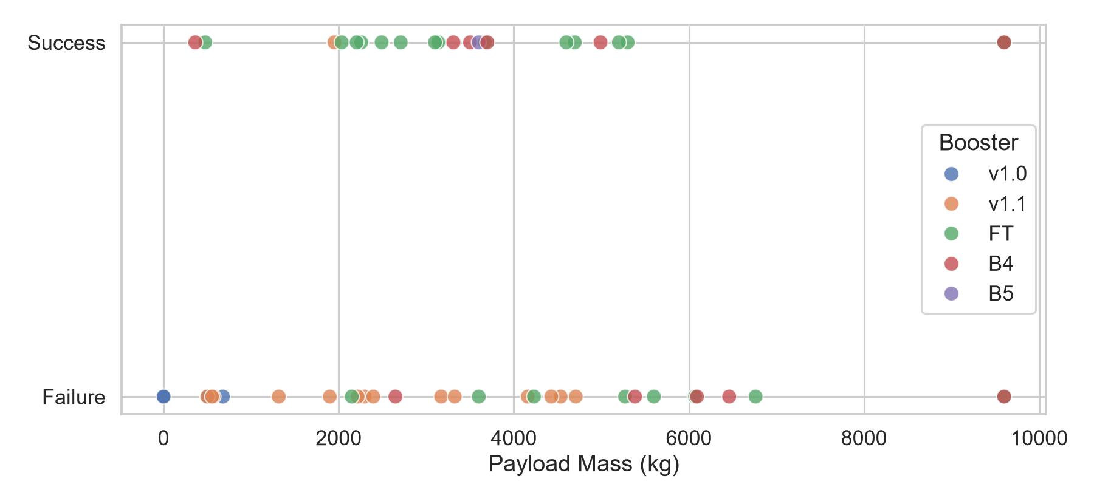
Payload vs Launch Outcome (All Sites)
Dash results
• Success by booster: v1.0 0% (0/5) · v1.1 7% (1/15) · FT 67% (16/24) · B4 55% (6/11) · B5 100% (1/1)
• Success by payload: 0–2k kg 23% · 2–4k kg 62% · 4–6k kg 38% · 6–10k kg 33%
• FT has the best rate among well-used boosters; 2,000–4,000 kg is the best payload range
IBM Applied Data Science Capstone · SpaceX Falcon 9
Notes:
Newer boosters land far more often. Payloads of 2,000 to 4,000 kg have the best record in this dashboard dataset.

Slide 40
Predictive Analysis (Classification)
Model results

Slide 41
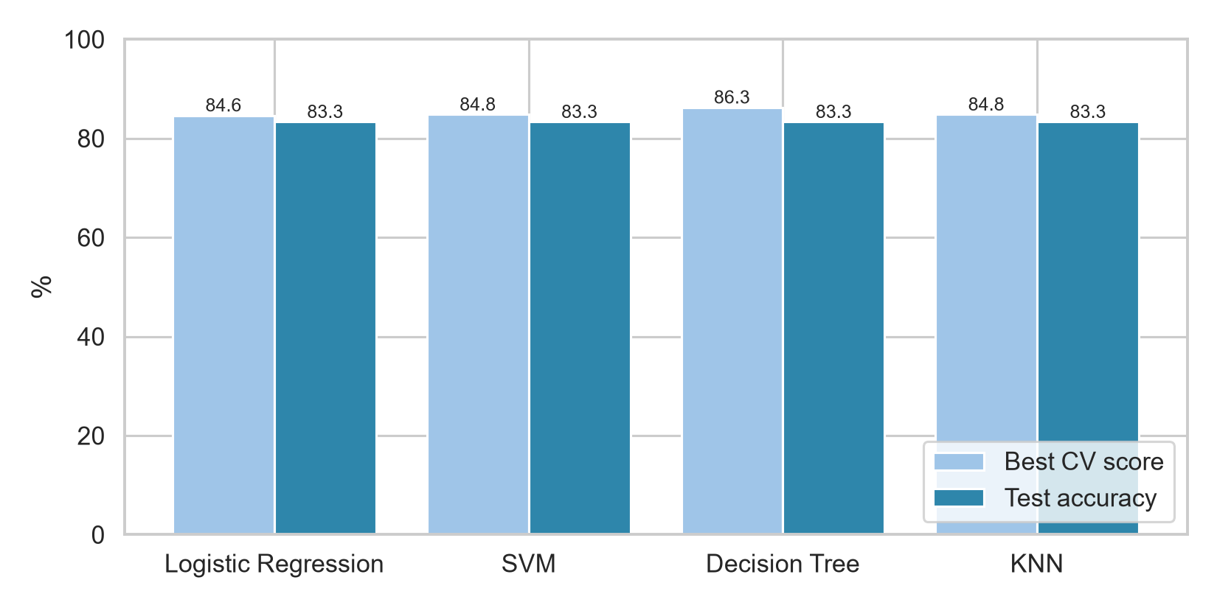
Classification Accuracy
ML results
Model | Best CV | Test
Logistic Regression | 84.6% | 83.3%
SVM | 84.8% | 83.3%
Decision Tree | 86.3% | 83.3%
KNN | 84.8% | 83.3%
• All four tie on test accuracy (15/18)
• Best model: Decision Tree, with the highest CV score (86.3%)
• With 18 test launches, one prediction = 5.6 points, so the models are effectively equal
IBM Applied Data Science Capstone · SpaceX Falcon 9
Notes:
All four models score 83.3% on the 18-launch test set. Decision Tree has the best cross-validation score, so I select it as the best model, with the caveat that differences are within noise for such a small test set.

Slide 42
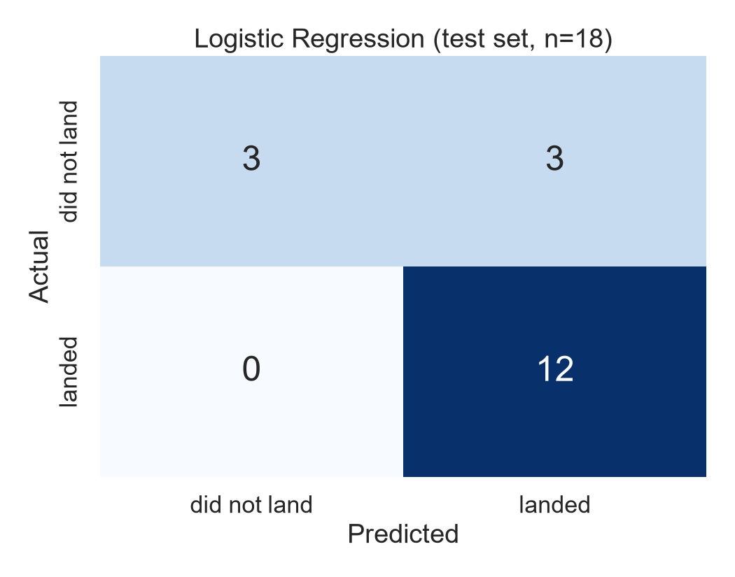
Confusion Matrix
ML results
• All four models give the same matrix on the test set
• 12 landings correctly predicted, 0 missed (recall 100%)
• 3 failures correctly predicted
• 3 failures wrongly predicted as landings (false positives)
• The model is optimistic: false positives are the main weakness
IBM Applied Data Science Capstone · SpaceX Falcon 9
Notes:
The model never misses a landing, but half the failures are predicted as landings. For a bidder, that means sometimes expecting a cheaper launch than reality. All four models produce this same matrix on the test set.

Slide 43
Conclusions
• Landing success follows a learning curve: 0% (2010–13) → 84–90% (2019–20)
• KSC LC-39A has the highest success rate (76.9%); newer boosters (FT, B5) land far more often
• Orbit matters: SSO and VLEO are reliable, GTO is about 50/50
• Tuned classifiers reach 83.3% test accuracy; Decision Tree is selected (best CV score, 86.3%)
• Insight for a competitor: recent, non-GTO missions on newer boosters → expect a reused (cheaper) first stage. Treat landing predictions for GTO cautiously because of false positives.
• Next steps: post-2020 launches, a larger test set, and features such as booster reuse count and weather
IBM Applied Data Science Capstone · SpaceX Falcon 9
Notes:
Experience, orbit, site and booster version drive landing success, and a simple model captures this at 83% accuracy. A bidder can use it to estimate SpaceX's likely launch cost, while staying cautious about over-optimistic predictions.

Slide 44
Appendix
• GitHub repository: https://github.com/Downey112/ibm-ds-capstone-spacex
– Notebooks: SpaceX API, web scraping, data wrangling, EDA visualisation, EDA SQL, Folium map, Plotly Dash app (.py), ML prediction
• Datasets: modelling dataset 90 rows · SQL table 101 rows · Dash dataset 56 rows
• Best hyperparameters:
– Logistic Regression: C=0.01, penalty=l2, solver=lbfgs
– SVM: C=1.0, gamma=0.0316, kernel=sigmoid
– Decision Tree: criterion=gini, max_depth=6, max_features=sqrt, min_samples_leaf=4, min_samples_split=10, splitter=random
– KNN: algorithm=auto, n_neighbors=10, p=1
• Proximity distances: OpenStreetMap features + haversine formula
IBM Applied Data Science Capstone · SpaceX Falcon 9
Notes:
All code is on GitHub. The three datasets differ in size, which is why some percentages differ between slides.

